Slide 1
Automated Cartography Solutions (ACS)
Providing A New Automated Mapping Solution

Slide 2
VIDEO
Maybe talk about why we wanted to do this before this slide.

Slide 3
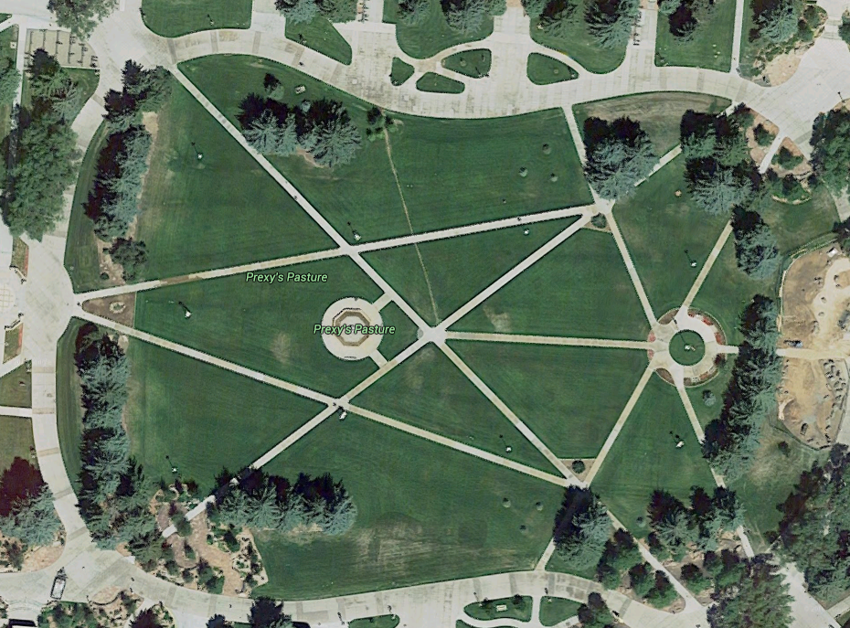
The Problem
Google Maps provides users with satellite images. That is great, but the images are update infrequently and low resolution

Slide 4
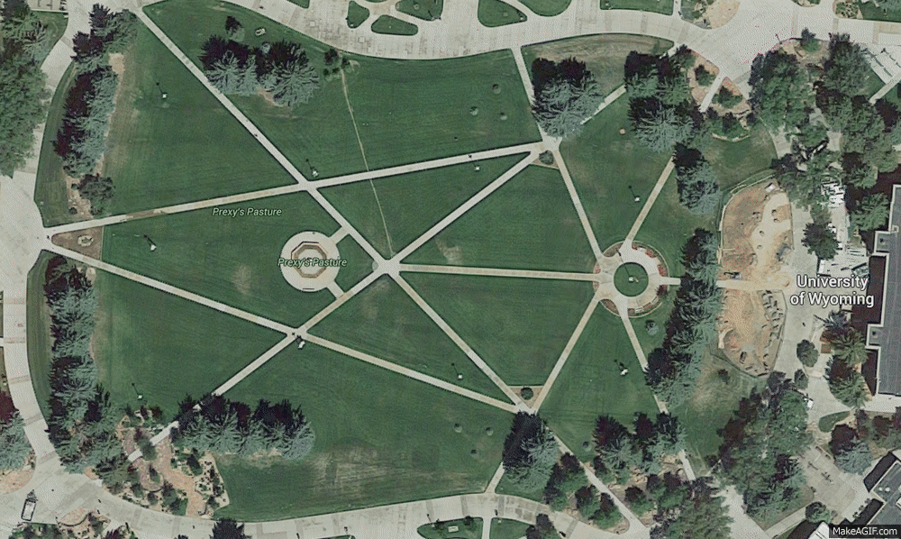
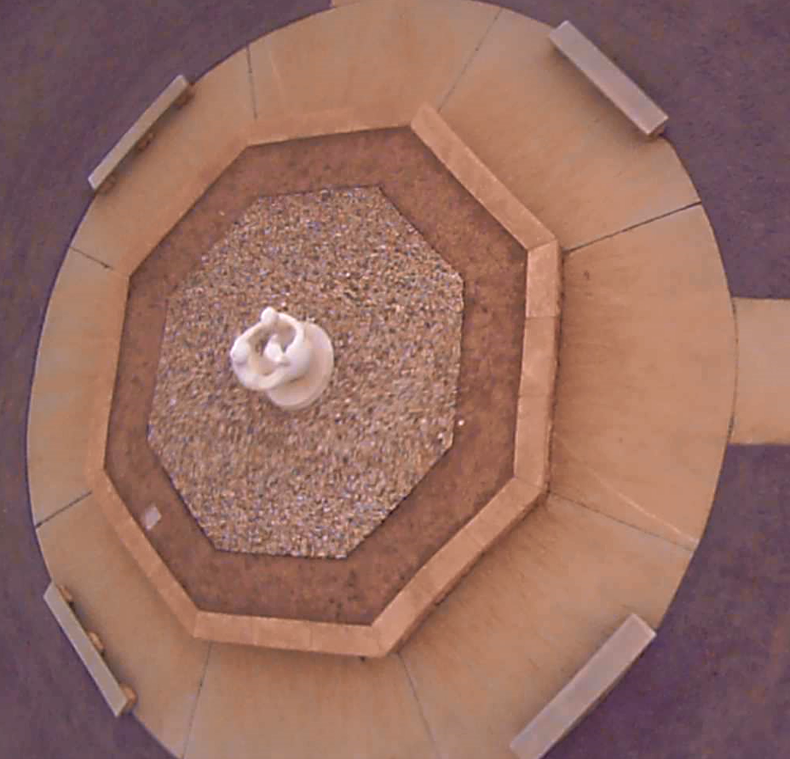
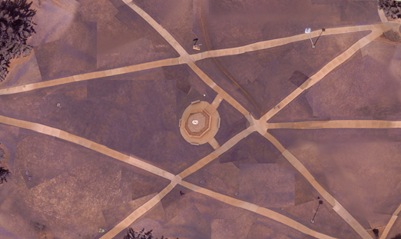
The Solution
Automated Cartography Solutions.
Notes:
500 img, 15mn

Slide 5
Potential Uses
Who needs maps updated often?
Open face mines
Construction companies
Farmers
Disaster Reconnaissance

Slide 6
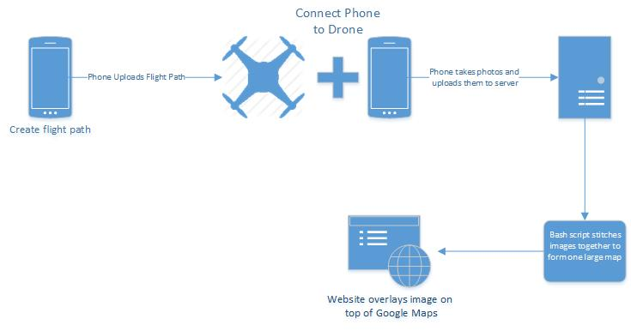
Project Overview

Slide 7

What we needed
Open source
Programmable
Payload of ~1lb
GPS functionality

Slide 8
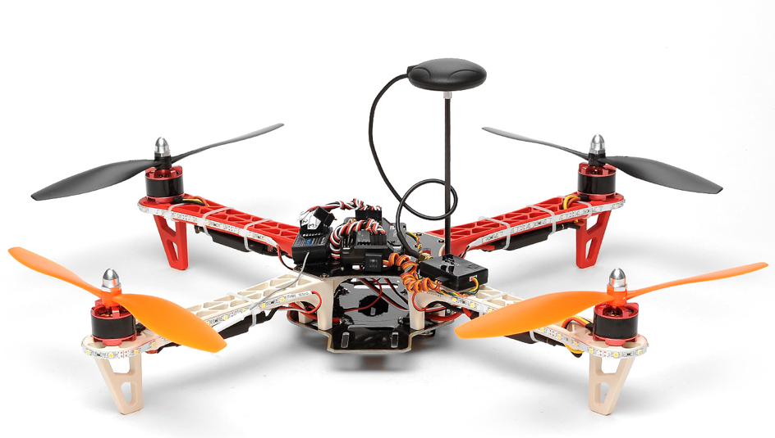
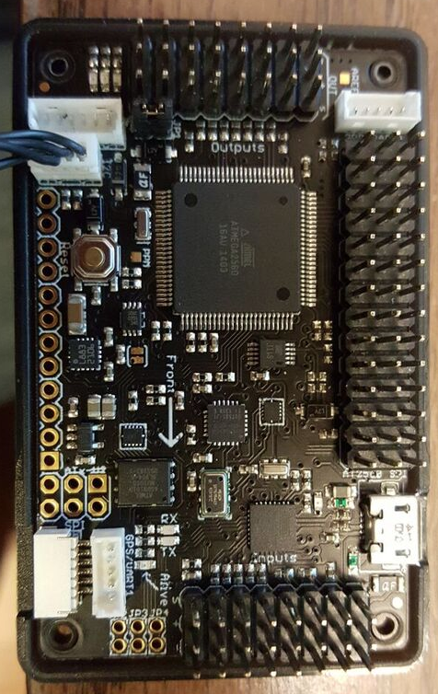
AeroSky P12 Quadcopter
Lipo-Battery
2200 mAh ~ 20 minutes flight time
APM 2.5 Arduino board
Open source and programmable
U-blox NEO-6M GPS module
Accuracy 3 – 5ft
2lb Payload
Notes:
Accuracy:
Position 2.5 m CEP
SBAS 2.0 m CEP
8

Slide 9
Drone and Phone
USB OTG adapter
USB host mode

Slide 10
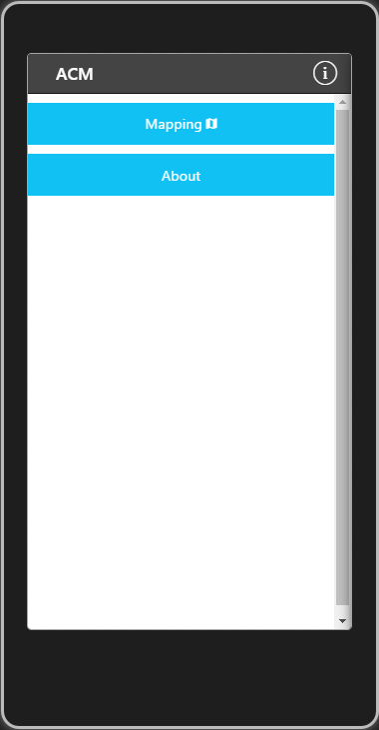
ACS App – Home

Slide 11
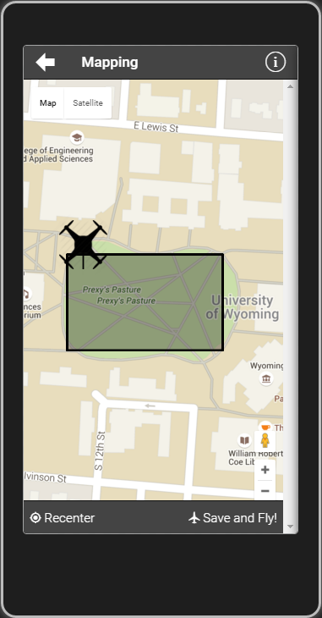
ACS App – Settings

Slide 12
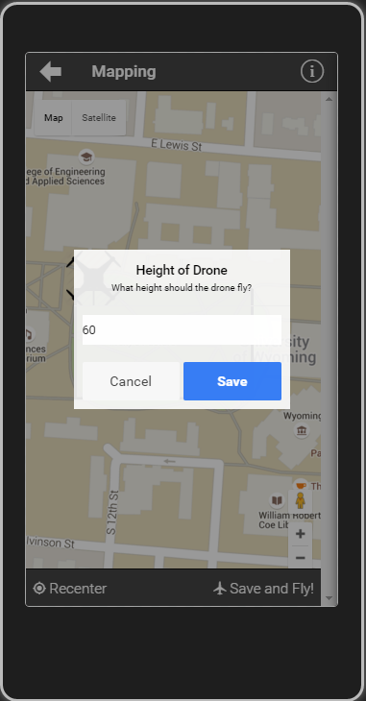
ACS App – Map

Slide 13
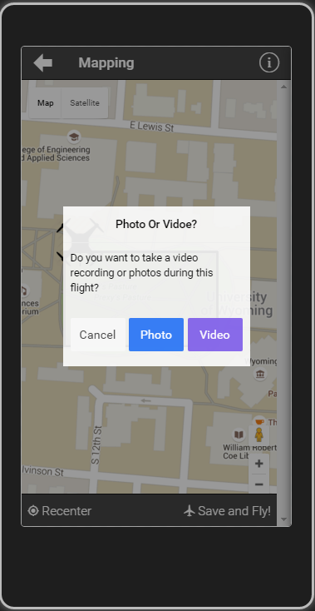
ACS App – Map

Slide 14
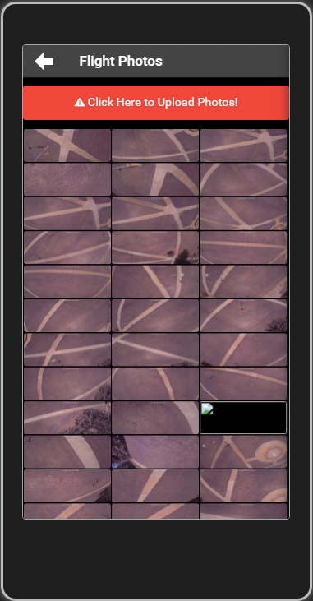
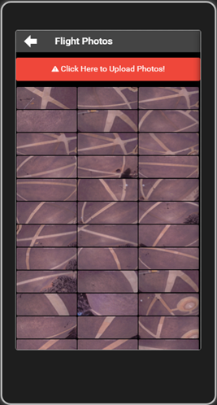
ACS App – Pictures

Slide 15
The Result
Notes:
500 img, 15mn

Slide 16
App Overview
Cross Platform app utilizing:
AngularJS (1.4)
Apache Cordova (3.5.1)
Ionic(1.2.4)
jQuery
Creates flight path
Takes photo/videos
Upload photos/videos to the server

Slide 17
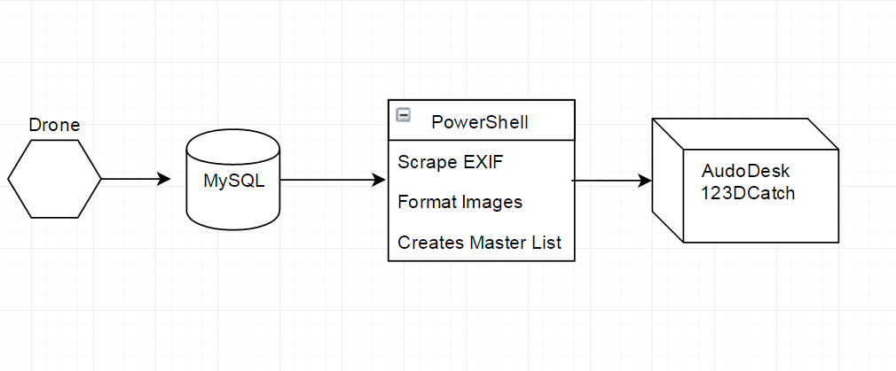
Server Infrastructure Overview

Slide 18
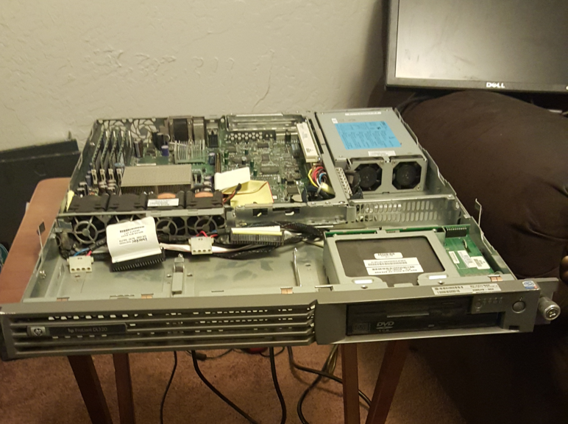
Primary Database Server
Running Windows Server 2012
Uses MySQL
Meta Data
Image Locations
Originally several bash scripts
HP ProLiant DL320

Slide 19
Server Side Code
Formats images to a uniform size
Scrapes image metadata
Enforces image naming conventions
Creates a master image list
Passes images to Autodesk 123D Catch

Slide 20

Autodesk 123D Catch
Creates 3D objects using a large set of images
Originally we created a system using ImageMagick and Javascript
Now we record video with the phone and scrape images from it using VLC Player

Slide 21
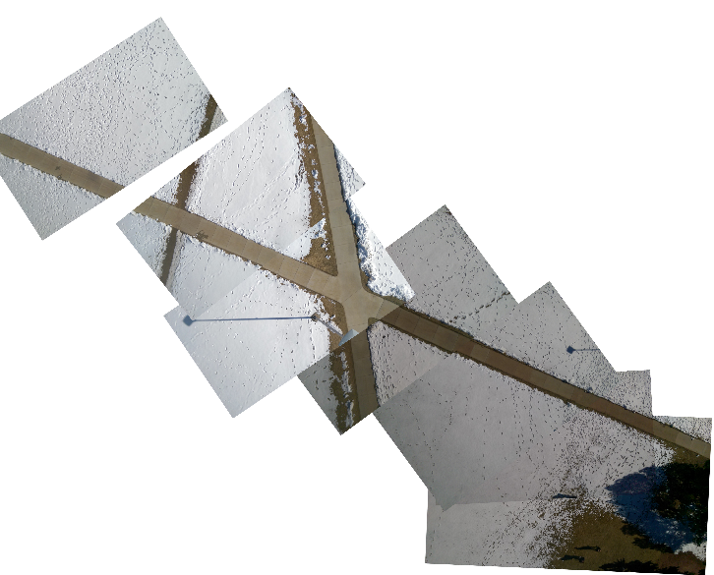
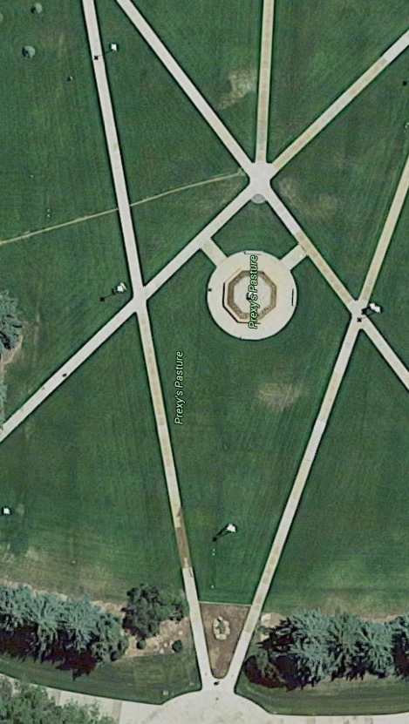
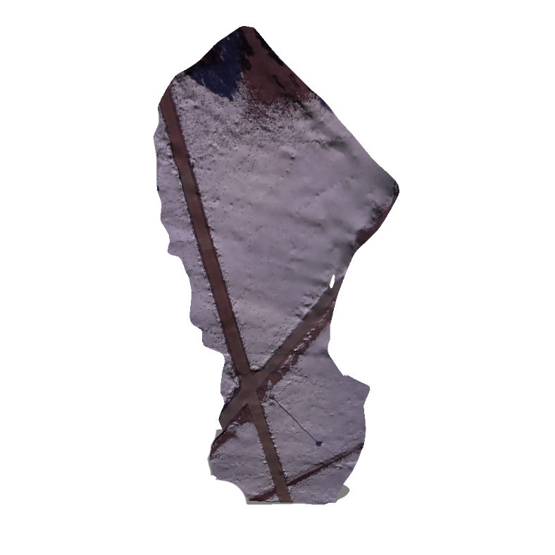
Original map
Autodesk Render

Slide 22
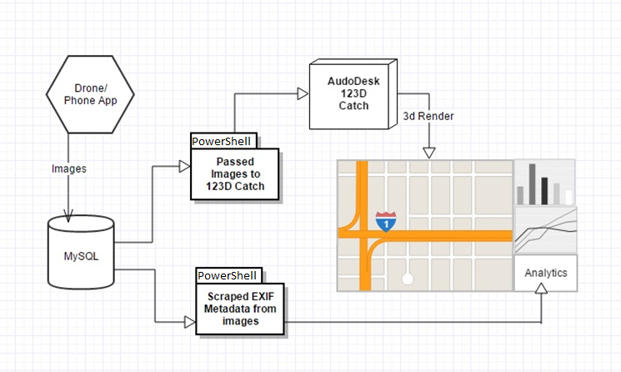
Future Plans (?)

Slide 23
Analytical Information
Average speed
Estimated distance between images
GPS information
EXIF data from picture
Notes:
Could be compiled into an automated report that can be emailed to the user after each flight.
23

Slide 24
Reporting Tools
Add Website
Maybe just a ton of logs from Mission Planner

Slide 25
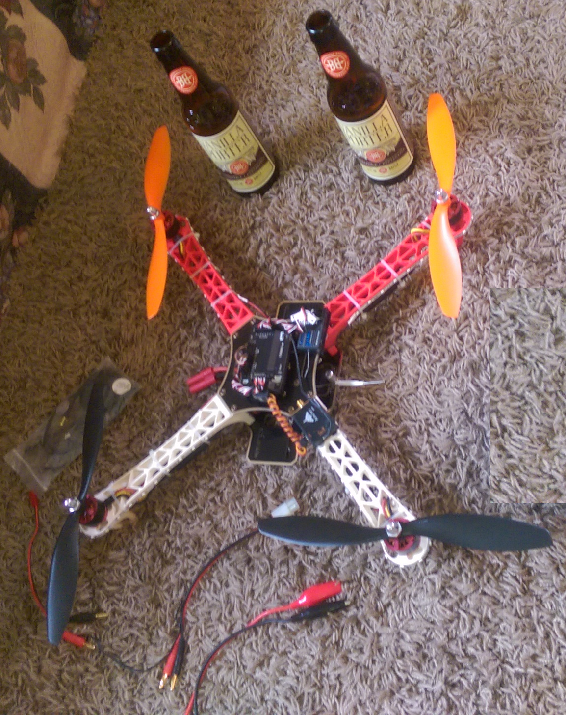
Overview
Hobbyists FFA compliment
Open Source
Low initial cost
Easy to use
Well documented
Notes:
Fly below 400 feet and remain clear of surrounding obstacles
Keep the aircraft within visual line of sight at all times
Remain well clear of and do not interfere with manned aircraft operations
Don't fly within 5 miles of an airport unless you contact the airport and control tower before flying
Don't fly near people or stadiums
Don't fly an aircraft that weighs more than 55 lbs
Don't be careless or reckless with your unmanned aircraft – you could be fined for endangering people or other aircraft

Slide 26
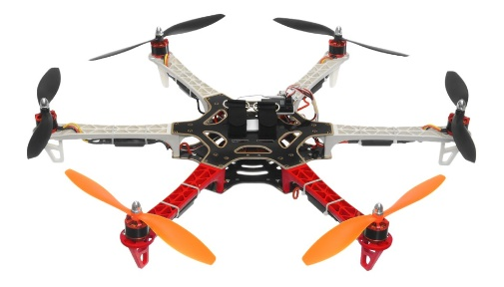
Future Improvements
Low cost hardware upgrades
Sonar
Hexa-Copter
Automatically generated reports
Camera stabilizing mount
Real time video rendering

Slide 27
Q
A
&
Notes:
27

